Slide 1
Data Warehousing Fundamentals and Google Cloud BigQuery Introduction
Exploring data warehousing and cloud solutions
Notes:
--- This presentation will provide an overview of data warehousing fundamentals, focusing on its definition, components, and benefits. We will also explore schema design principles, the Google Cloud Platform, and specifically delve into Google Cloud BigQuery and its features.

Slide 2
Agenda Items
Data Warehousing Fundamentals
Schema Design in Data Warehousing
Google Cloud Platform Overview
Schema Design on Google Cloud
Introduction to BigQuery
Getting Started with BigQuery
Notes:
In this presentation, we will cover data warehousing fundamentals, including its definition and purpose, components, and benefits. We will explore schema design in data warehousing, an overview of the Google Cloud Platform, and how it supports data warehousing, followed by a detailed introduction to BigQuery and getting started with it.

Slide 3
Data Warehousing Fundamentals
Notes:
Data warehousing is a key element in business intelligence and analytics, providing a centralized repository for data. Understanding its fundamentals is crucial for effective decision-making and data analysis.

Slide 4

Definition and Purpose of Data Warehousing
Central Repository
A data warehouse serves as a central repository for storing integrated data from various sources to facilitate easy access and analysis.
Support Decision-Making
The primary purpose of a data warehouse is to support decision-making processes by providing accurate and timely insights from consolidated data.
Reporting and Analysis
Data warehouses enable comprehensive reporting and data analysis, allowing organizations to derive actionable insights and trends from their data.
Notes:
A data warehouse is a system used for reporting and data analysis, acting as a central repository for integrated data from various sources. Its purpose is to support decision-making processes and provide insights.

Slide 5

Components of a Data Warehouse
Data Sources
Data sources are the origins of data, which can include databases, files, and external systems. They provide the raw data needed for analysis.
Data Integration Tools
Data integration tools are essential for consolidating data from multiple sources into a cohesive format suitable for analysis. They help ensure data quality and consistency.
Data Warehouse
The data warehouse itself is a centralized repository that stores integrated data, making it easier to access and analyze large volumes of data.
Front-end Tools
Front-end tools are used for querying and reporting data from the warehouse, enabling users to generate insights and make data-driven decisions.
Notes:
The main components of a data warehouse include data sources, data integration tools, the data warehouse itself, and front-end tools for querying and reporting. Each component plays a vital role in the overall functionality.

Slide 6

Benefits of Data Warehousing
Improved Data Quality
Data warehousing enhances data quality by consolidating information from various sources, ensuring accuracy and consistency.
Historical Analysis
Organizations can perform historical analysis using data warehousing, allowing them to identify trends and make future predictions.
Enhanced Reporting Capabilities
Data warehousing provides enhanced reporting capabilities that enable organizations to generate comprehensive reports and dashboards.
Informed Decision-Making
With insights gained from data warehousing, organizations can make informed decisions that drive strategic growth and efficiency.
Notes:
Data warehousing offers numerous benefits, such as improved data quality, historical analysis, and enhanced reporting capabilities. It allows organizations to gain insights and make informed decisions.

Slide 7
Schema Design in Data Warehousing
Notes:
Schema design is critical in data warehousing as it determines how data is organized, stored, and accessed. Understanding effective schema design can optimize query performance and data retrieval.

Slide 8
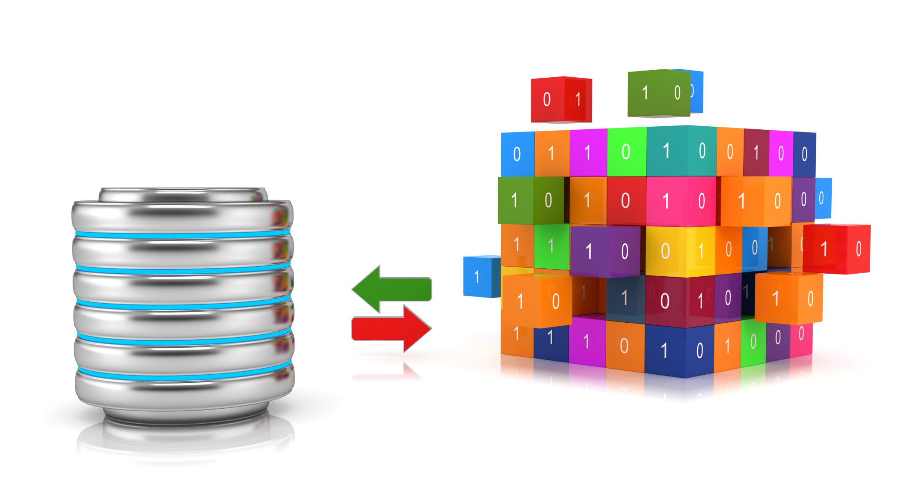
Introduction to Database Schemas
Definition of Database Schema
A database schema is a blueprint that defines the organization of data and the relationships between different data elements.
Tables and Relationships
Schemas involve tables that store data and define relationships that dictate how data is connected across the database.
Constraints in Schemas
Constraints in a schema ensure data integrity by enforcing rules on data entry and relationships.
Notes:
Database schemas define the structure of a database, including tables, relationships, and constraints. Proper schema design ensures efficient data storage and retrieval in data warehousing.

Slide 9
Star Schema and Snowflake Schema
Star Schema Overview
The star schema features a centralized fact table connected to dimension tables, simplifying data retrieval and analysis.
Snowflake Schema Overview
The snowflake schema normalizes dimension tables into multiple related tables, resulting in a more complex structure but efficient storage.
Query Complexity
Queries in a snowflake schema can be more complex due to additional joins, while star schema queries are generally simpler.
Notes:
Star schema and snowflake schema are two common database designs in data warehousing. Star schema uses a centralized fact table with related dimension tables, while snowflake schema normalizes dimension tables into additional tables, leading to more complex queries.

Slide 10
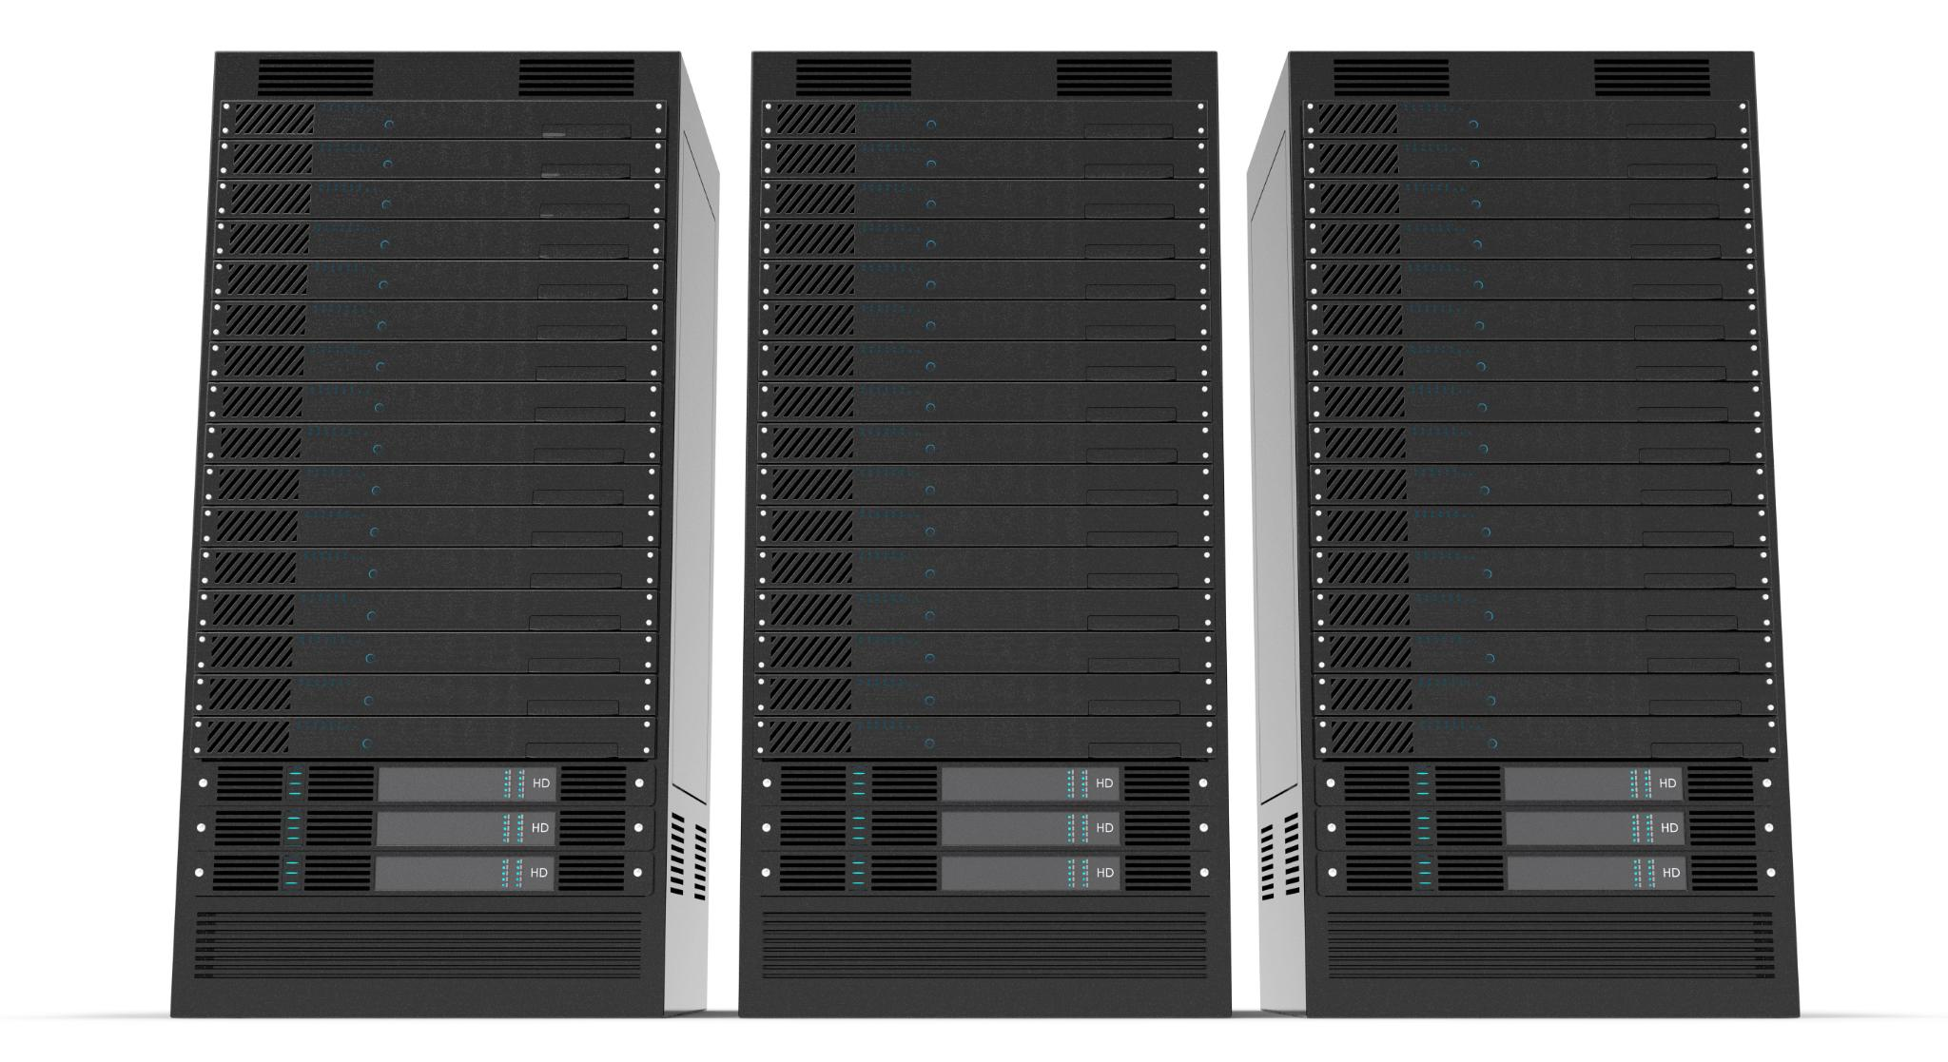
Best Practices for Schema Design
Clarity in Table Relationships
Ensuring clarity in table relationships is essential for effective schema design and better understanding of data relationships.
Optimizing Indexing Strategies
Optimizing indexing strategies can significantly improve database performance and speed up query execution times.
Considering Query Patterns
Considering query patterns during schema design helps in creating a more efficient and manageable database structure.
Notes:
Best practices for schema design include ensuring clarity in table relationships, optimizing indexing strategies, and considering query patterns. These practices can greatly enhance performance and manageability.

Slide 11
Google Cloud Platform Overview
Notes:
Google Cloud Platform (GCP) provides a robust infrastructure for data warehousing, offering various tools and services that facilitate data management, storage, and analytics.

Slide 12

Introduction to Google Cloud Platform
Comprehensive Cloud Services
Google Cloud Platform offers a wide range of cloud computing services designed to meet diverse business needs.
Infrastructure Similar to Google Products
GCP operates on the same robust infrastructure that powers Google's end-user products, ensuring reliability and performance.
Flexible and Scalable Environment
GCP provides a flexible and scalable environment, allowing businesses to deploy applications and manage data efficiently.
Notes:
GCP is a suite of cloud computing services that runs on the same infrastructure as Google’s end-user products. It provides a flexible and scalable environment for deploying applications and managing data.

Slide 13

Key Services and Tools for Data Management
BigQuery for Data Warehousing
BigQuery is a powerful data warehousing solution that allows for efficient querying of large datasets, enabling quick insights and analytics.
Cloud Storage Solutions
Cloud Storage provides scalable and secure storage options for data, supporting various data types and easy access from anywhere.
Dataflow for Data Processing
Dataflow enables real-time data processing and analytics, allowing for automated data workflows and improved efficiency in handling large volumes of data.
Notes:
GCP offers several key services for data management, including BigQuery for data warehousing, Cloud Storage for data storage, and Dataflow for data processing. These tools help streamline data workflows and improve analysis efficiency.

Slide 14

Benefits of Using Google Cloud for Data Warehousing
Scalability
Google Cloud offers scalable solutions that can adapt to growing data needs and business requirements seamlessly.
Cost-Effectiveness
Utilizing Google Cloud for data warehousing can reduce costs by eliminating the need for on-premises infrastructure and maintenance.
Integrated Security
Google Cloud provides robust security measures that protect sensitive data while ensuring compliance with industry standards.
Advanced Analytics
The platform supports advanced analytics and machine learning capabilities, providing valuable insights and improving decision-making.
Notes:
Using Google Cloud for data warehousing provides benefits such as scalability, cost-effectiveness, integrated security, and advanced analytics capabilities, making it a preferred choice for businesses.

Slide 15
Schema Design on Google Cloud
Notes:
Designing schemas on Google Cloud involves understanding the unique capabilities of the platform and how it integrates with various services to optimize performance and manageability in data warehousing.

Slide 16

Creating and Managing Schemas in Google Cloud
Understanding BigQuery
BigQuery is Google's fully-managed, serverless data warehouse that allows for scalable analysis of large datasets.
Defining Datasets and Tables
Users can create and manage datasets and tables using the Google Cloud console, enabling easy organization of data.
Flexible Schema Management
Google Cloud provides flexible schema management options through APIs or SQL commands for efficient data handling.
Notes:
Creating and managing schemas in Google Cloud requires familiarity with BigQuery and its features. Users can define datasets and tables through the console, APIs, or SQL commands, allowing for flexible schema management.

Slide 17

Integration with Other Google Cloud Services
Enhancing Data Warehousing
Integrating Google Cloud services can significantly enhance data warehousing capabilities and improve data management.
BigQuery and Dataflow
Combining BigQuery with Dataflow allows for efficient data processing and analysis, optimizing the data workflow.
Event-Driven Tasks
Using Cloud Functions for event-driven tasks enhances automation in workflows, making processes more efficient.
Notes:
Google Cloud services can be integrated to enhance data warehousing functionality. For example, combining BigQuery with Dataflow for data processing or Cloud Functions for event-driven tasks can optimize workflows.

Slide 18

Best Practices for Schema Design on Google Cloud
Using Partitioned Tables
Implementing partitioned tables is essential for managing large datasets efficiently, improving query performance and reducing costs.
Optimizing for Query Patterns
Understanding and optimizing for your specific query patterns can significantly enhance the efficiency of data retrieval.
Leveraging Denormalization
Denormalization can simplify your schema and reduce complexity, leading to quicker and more efficient queries.
Notes:
Best practices for schema design on Google Cloud include using partitioned tables for large datasets, optimizing for query patterns, and leveraging denormalization to reduce query complexity, which enhances performance.

Slide 19
Introduction to BigQuery
Notes:
BigQuery is Google Cloud's fully-managed, serverless data warehouse that enables scalable analysis of large datasets. Its architecture allows users to run SQL queries without managing infrastructure.

Slide 20
Overview of BigQuery
Fast SQL Queries
BigQuery is optimized for fast SQL queries, allowing users to analyze large datasets quickly and efficiently.
Diverse Data Formats
BigQuery supports various data formats, making it versatile for different data analysis needs and applications.
Built-in Machine Learning
With built-in machine learning capabilities, BigQuery enables users to perform advanced analytics without needing extensive ML expertise.
Notes:
BigQuery is designed for fast SQL queries and analysis of large datasets. It supports various data formats and provides built-in machine learning capabilities, making it suitable for diverse use cases.

Slide 21

Key Features and Capabilities
Automatic Scaling
BigQuery offers automatic scaling to accommodate varying workloads, ensuring optimal performance without manual intervention.
Real-Time Analytics
With real-time analytics, BigQuery allows users to gain insights from data as it is generated, enabling timely decision-making.
Complex Queries Support
BigQuery supports complex queries, allowing users to execute intricate data analyses efficiently and effectively.
Security Features
BigQuery includes robust security features to protect data, ensuring compliance and safeguarding sensitive information.
Notes:
Key features of BigQuery include automatic scaling, real-time analytics, and support for complex queries. It also offers security features and integrations with other Google services.

Slide 22

Use Cases and Applications
Data Analytics
BigQuery enables efficient data analytics across industries, transforming raw data into actionable insights.
Reporting Capabilities
With its robust reporting features, BigQuery allows businesses to generate comprehensive reports to inform decision-making.
Machine Learning Integration
BigQuery's support for machine learning tasks makes it a powerful tool for predictive analytics and model development.
Notes:
BigQuery is used across various industries for analytics, reporting, and data science applications. Its ability to handle large data volumes makes it ideal for business intelligence and machine learning tasks.

Slide 23
Getting Started with BigQuery
Notes:
Getting started with BigQuery involves setting up an account, creating projects, and loading data. This section will guide users through the initial steps to begin utilizing BigQuery effectively.

Slide 24

Setting up a BigQuery Environment
Create Google Cloud Account
The first step is to create a Google Cloud account which grants access to BigQuery and other cloud services.
Navigate to BigQuery Console
Once the account is created, navigate to the BigQuery console to access data management features and tools.
Configure Datasets and Tables
After accessing the console, configure datasets and tables to organize and manage your data effectively.
Notes:
Setting up a BigQuery environment requires creating a Google Cloud account, navigating to the BigQuery console, and configuring datasets and tables to start working with data.

Slide 25
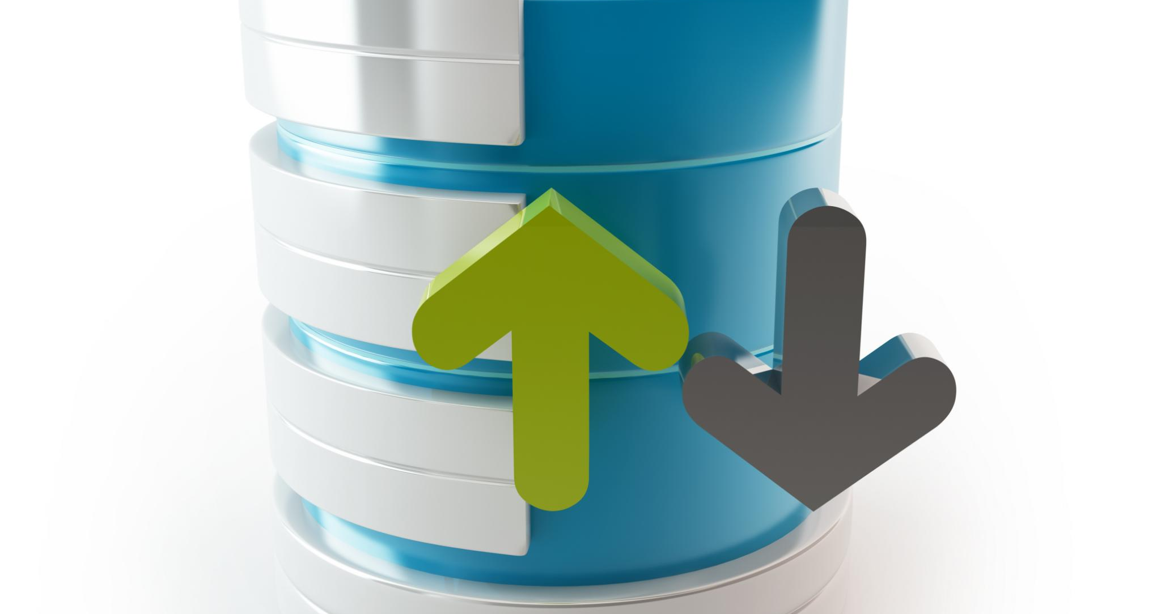
Loading and Querying Data
Data Loading Methods
Loading data into BigQuery can be accomplished through various methods, including CSV uploads or real-time streaming.
Standard SQL Queries
Once data is loaded, users can perform queries using standard SQL syntax for effective data analysis.
Powerful Data Analysis
The ability to query data with SQL allows for in-depth and powerful analysis of large datasets.
Notes:
Loading data into BigQuery can be done through various methods, such as CSV uploads or streaming data. Users can then query the data using standard SQL, allowing for powerful data analysis.

Slide 26

Optimization and Performance Tips
Partitioned Tables
Using partitioned tables can significantly improve query performance by limiting the amount of data scanned during execution.
Clustering
Clustering data can help to further optimize queries by grouping similar data together, reducing query times.
Query Structuring
Proper query structuring is essential for performance. Well-structured queries are easier for the database to optimize.
Notes:
To optimize performance in BigQuery, users can utilize partitioned tables, clustering, and proper query structuring. These techniques help reduce costs and improve query execution speed.

Slide 27
Conclusion
Importance of Data Warehousing
Data warehousing fundamentals are crucial for efficient data management and analytics, enabling better decision-making.
Utilizing BigQuery
Tools like Google Cloud BigQuery provide powerful capabilities for processing and analyzing large datasets quickly.
Gaining Insights
With the right design and practices in place, businesses can uncover valuable insights from their data effectively.
Notes:
In conclusion, understanding data warehousing fundamentals and utilizing tools like Google Cloud BigQuery can significantly enhance data management and analytics capabilities. With the right design and practices, businesses can gain valuable insights from their data.

